Slide 1

Identifying key signals from data using Anomaly Detection
Archish Ramesh Babu(ARAMESHB)
Gopal Seshadri(GSESHAD)
Agastya Teja Anumanchi(AANUMANC)

Slide 2
Content
Why are doing this?
A look at the data
Evaluation metric
Algorithms
Results
Real world application
Expansion to Multidimensional data
Next steps
Questions

Slide 3
Anomaly Detection using unsupervised methods saves a lot of time and cost
Why are we doing this?
How are we doing it?
What are we doing?
Anomaly Detection is a popular machine learning concept that helps identify data points that don’t follow conventional behavior
This concept has been widely used in fields like Fraud Detection, Medical Diagnosis to name a few
Due to the disruption caused by IoT, Social media new time series data(eg : sensor data) is bring generated at a rapid pace
Companies need to quickly analyze new data to stay competitive and implementing traditional supervised Anomaly Detection methods will take a lot of time and effort to set up
We are building an unsupervised learning algorithms framework to help identify the anomalous points without any labelled data on time series data
This will reduce the reaction time to anomalies
The anomalies identified using unsupervised Machine Learning could later be used to built supervised models
We are using popular unsupervised algorithms like Isolation Forest, One-class SVM, K-means to identify anomalous points
The algorithms were chosen so that they could be scaled to multidimensional data as well
We are also validating these algorithms by testing their performance against 67 different time series data provided by Yahoo

Slide 4
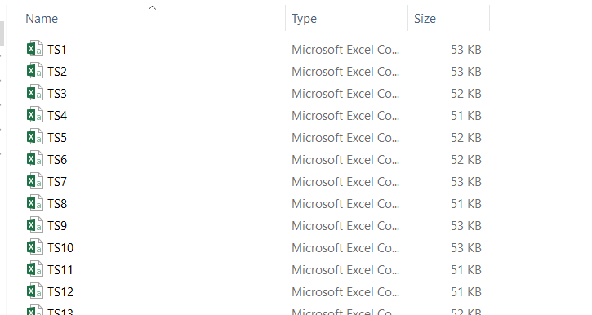
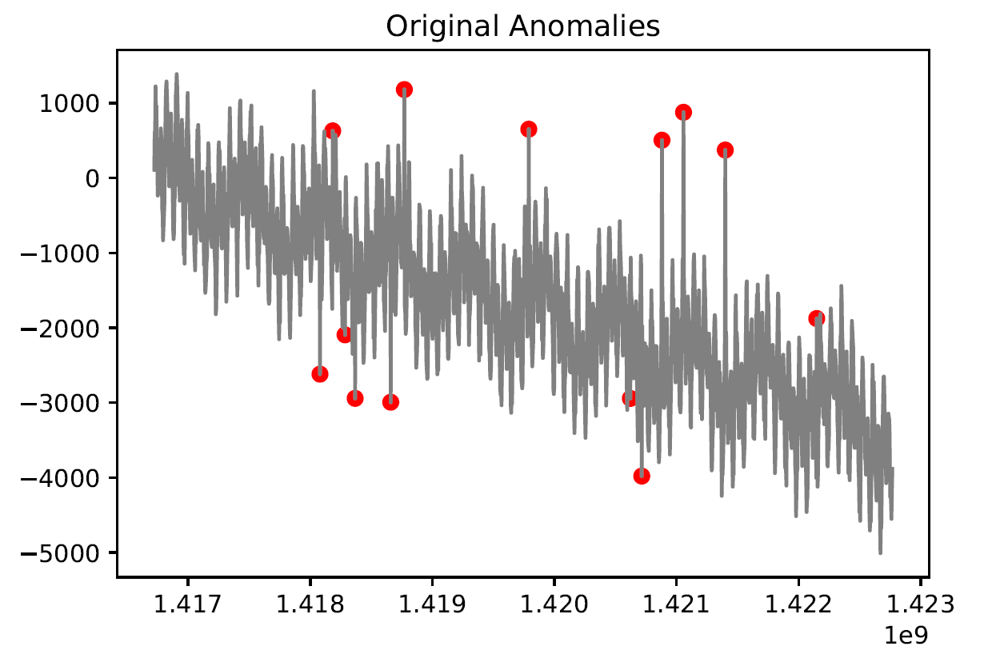
Yahoo has provided multiple time series datasets that could be used to benchmark Anomaly Detection algorithms
Time stamp | Value | Anomaly
1416722400 | -46.3943564 | 0
1416726000 | 311.3462336 | 0
1416729600 | 543.279051 | 0
1416733200 | 603.4419825 | 0
1416736800 | 652.8072434 | 0
1416740400 | 429.8209026 | 0
Data
We had written a request to Yahoo and obtained 67 times series anomaly detection benchmarking files
The data is partly from yahoos real data along with some syntactic data and the anomalies have been tagged manually by yahoo engineers
We are using these files to benchmark the performance of our algorithms

Slide 5
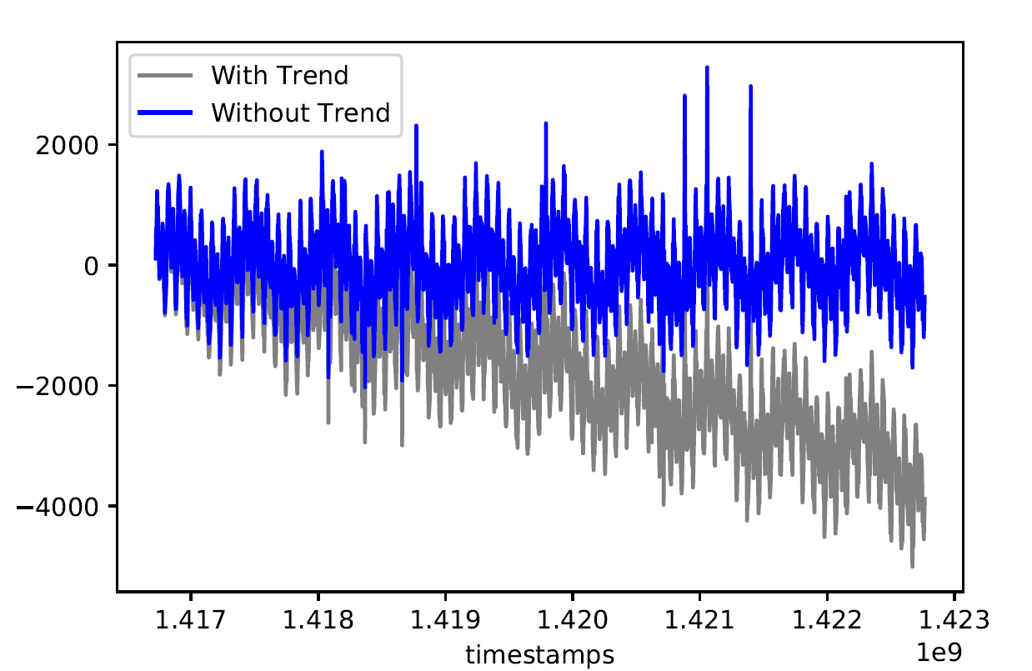
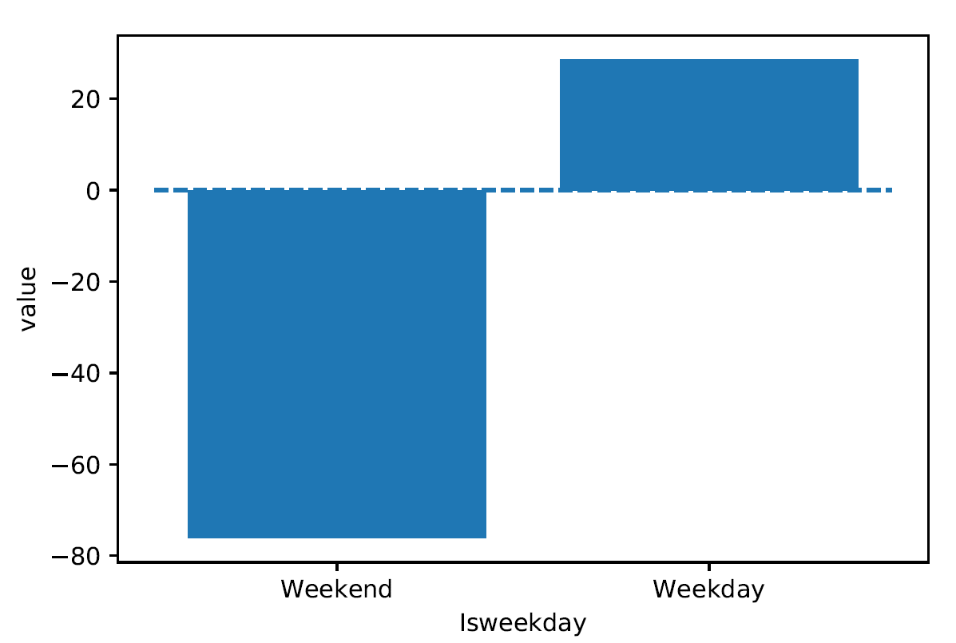
Data has both trend and seasonality which needs to be accounted before tagging anomalies
Trend
Seasonality
Time series data has a lot of trend, the sales of a new product is expected to increase over time
Now the increase should not be tagged as an anomaly but the sudden spike or dip in the sales should be correctly identified as soon as possible for the business teams to take necessary action
The trend was removed using the Beta coefficient simple linear Regression model, between the position of the value and the value
In addition to trend the time series data also has a lot of seasonality, the traffic during the weekends is generally higher on websites due to the additional time or it could be vice verse in other cases
Above is an image of how the time series varies by the day of a week after removing trend for a particular file

Slide 6



Recall and F1 score important metrics to be considered while evaluating Anomaly Detection Algorithms
Recall
Precision
Recall metric measures the number of Anomalous points that the model is able to correctly tag to the total number of anomalous points in the data
The precision is the ratio of the number of correctly tagged anomalous points to the total number of points tagged as anomaly
$$Recall=\frac{True Positive }{True Positive+False Negative}$$
$$Precision=\frac{True Positive }{True Positive+False Positive}$$
F1 Score
F1 Score is the harmonic mean of recall and precision.
This metric shows the balance between Recall and Precision, the ideal value for F1 score is 1
$$F1 Score=\frac{2 ∗Recall ∗Precision}{Recall+Precision}$$

Slide 7
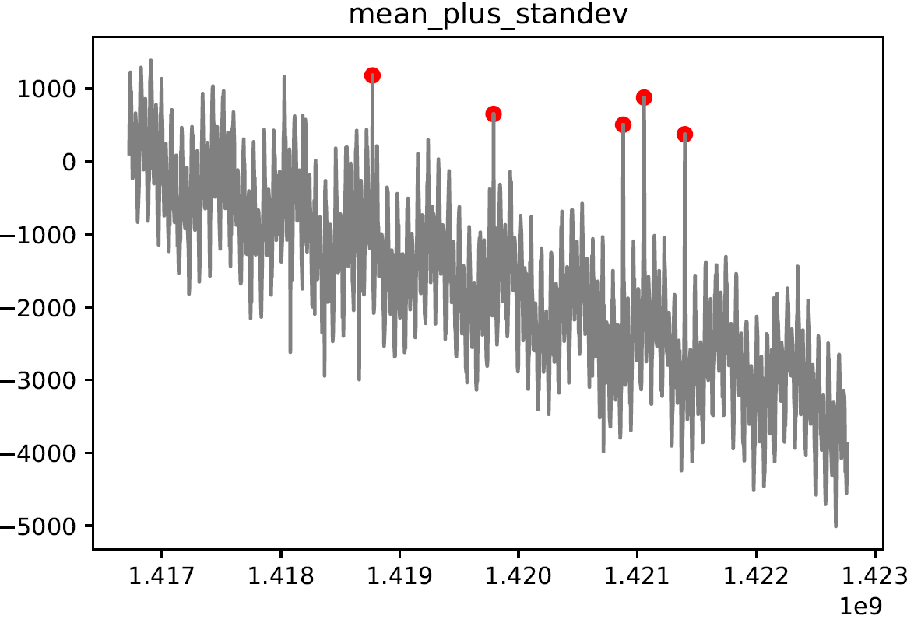
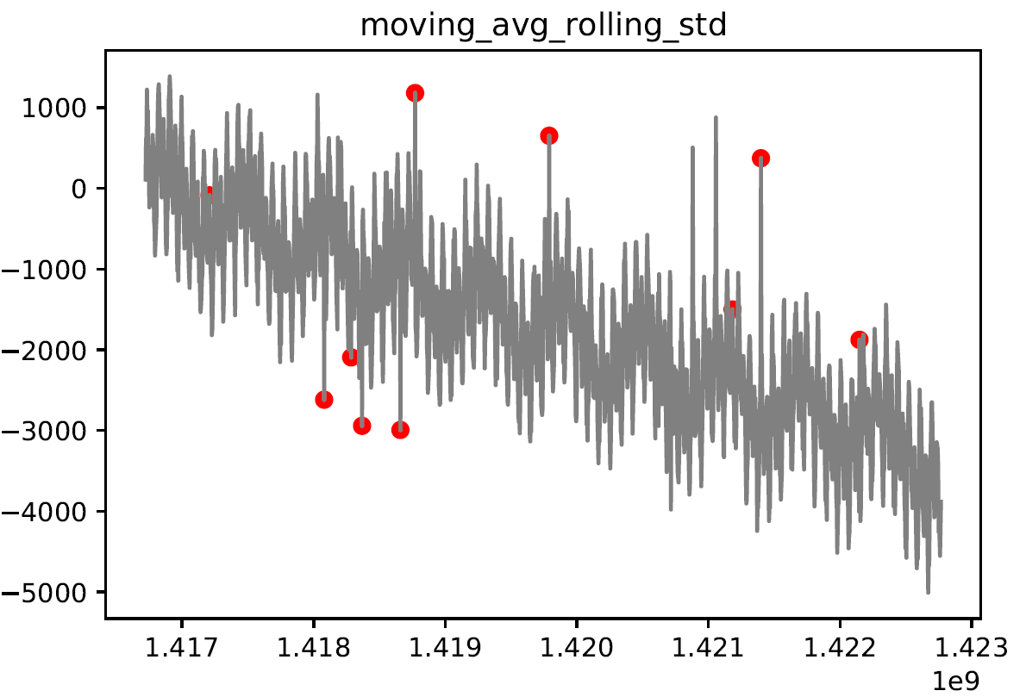
After treating for trend, the models using mean plus standard deviation are able to tag some anomalies
Recall : 0.373:
Recall : 0.599 :
Model performance
The most intuitive way to detect anomalous points for univariate data like time series data is to use its statistical properties such as mean and standard deviation to find out extreme points in the data.
In this method we implement this by finding the average value of the entire data and find out points which fall outside certain standard deviation(for the purpose of this exercises we are using 3 standard deviations) .
These models are able to identify some of the anomalies, next lets see how some of the popular ML algorithms perform in comparison

Slide 8
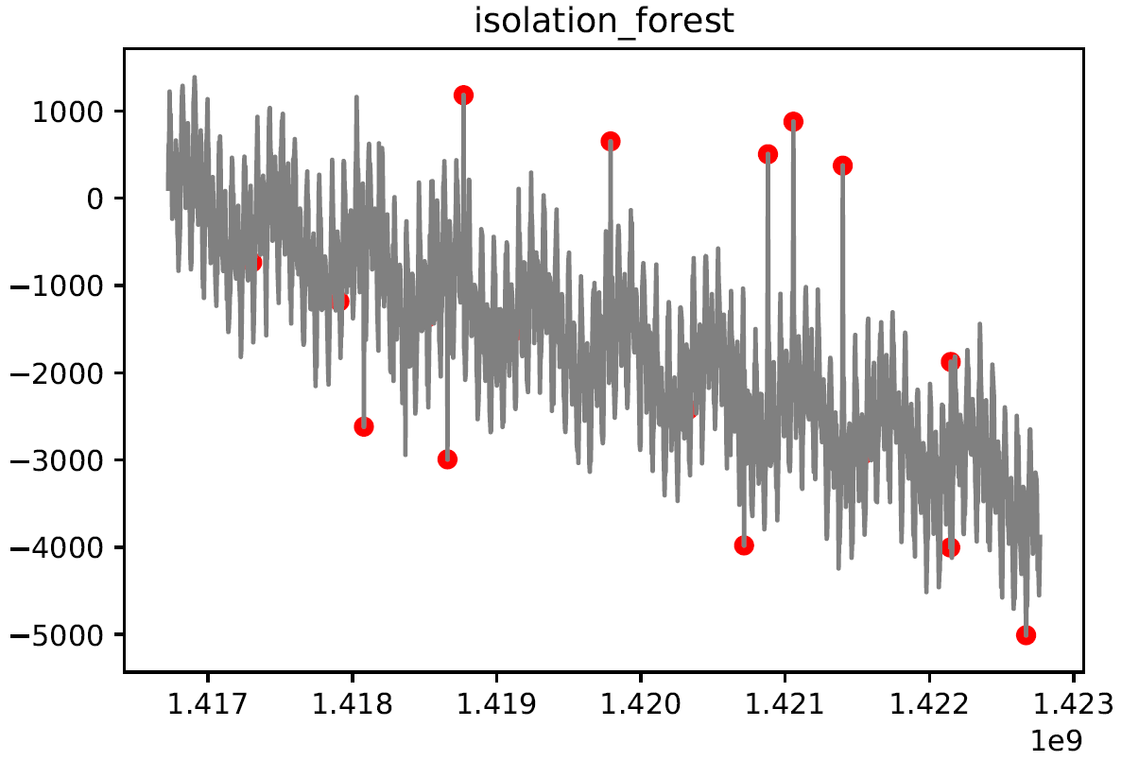
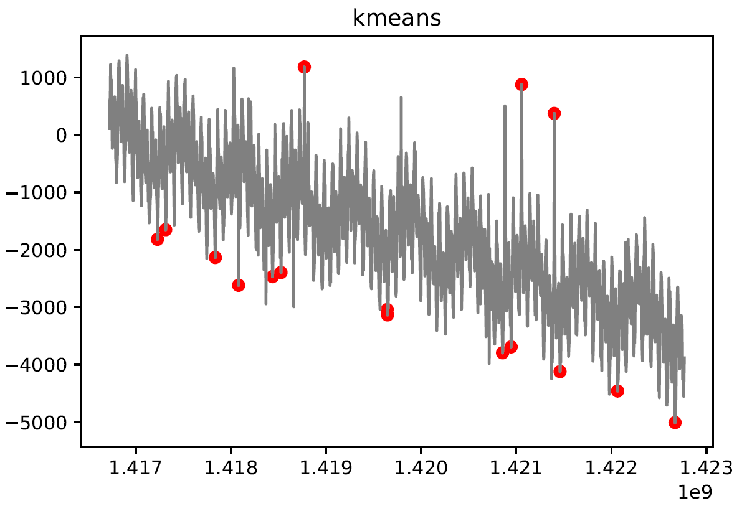
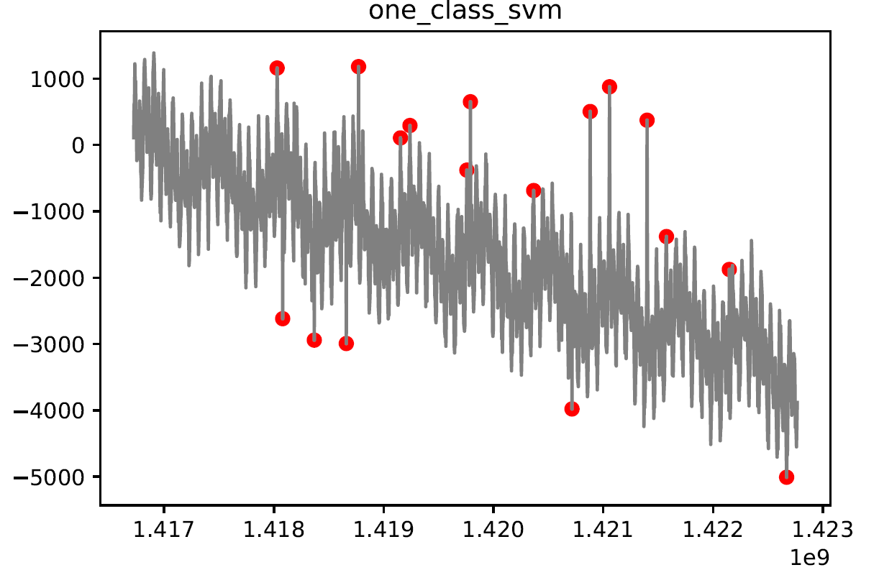
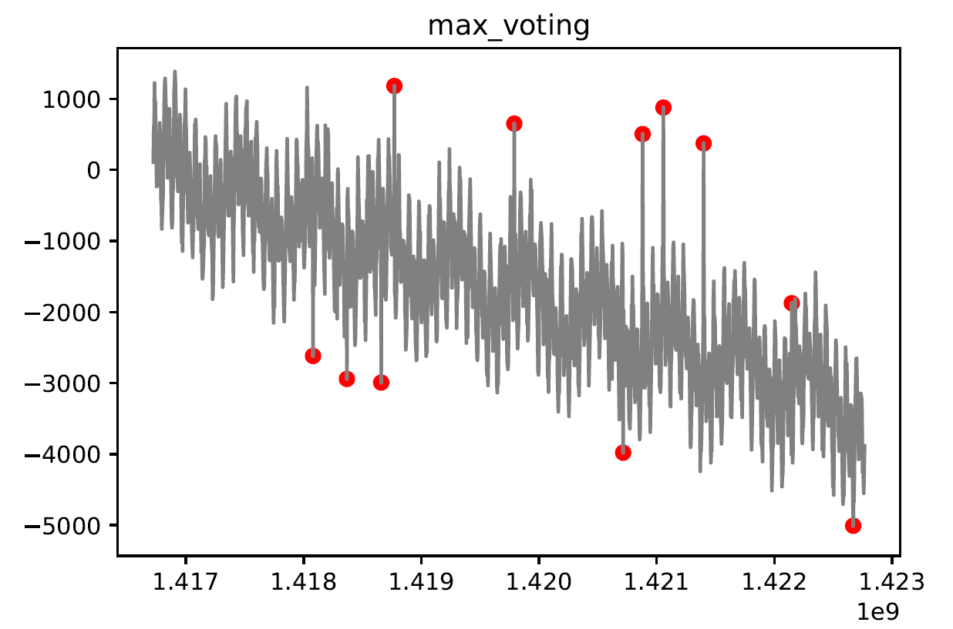
Isolation Forest and One-class SVM are able to identify majority of the Anomalous points
Result
One-class SVM is performing quite well in identifying the anomalous points followed by Isolation Forest and then K-means
Isolation forest however runs faster compared to other algorithms
Max voting is helpful in reducing the number of False Positives.
Lets see how these results generalize when we run them on 67 files
Recall : 0.609 :
Recall : 0.393
Recall : 0.845 :
Recall : 0.771

Slide 9
How do these Algorithms work?(1/2)
Algorithm | How they work?
Moving Average with Rolling Standard Deviation | Mean + Standard Deviation model is that the mean is heavily influenced by fluctuations To avoid this a rolling window is chosen and average is taken over those points in the window This rolling window precedes the point which we are trying to detect anomaly or not
One Class SVM | One class SVM – a variant of SVM - can only used for binary classification, one class belonging to the normal data and the other class belonging to the anomalous data The model is trained on data with no anomalies but the model is not affected much even if it is trained with some anomalous points because the model has an inbuilt parameter that creates a soft boundary which minimized the effect of a few data points on the model prediction
Isolation Forest | Isolation forest is built on the concept of the Decision Trees The model tries to anomaly points by randomly splitting each variable by looking the depth of the tree, the points identified with less depth are considered as anomalies since they would be away from the major chuck of the data The isolation forest also runs with linear complexity and is performs parallel processing

Slide 10
How do these Algorithms work?(2/2)
Algorithm | How they work?
K Means | This is a distance-based anomaly detection method, in this method we first specify the number of clusters to be created Once these clusters are formed based on the distance between the point and the cluster. The points which have a very large distance from the clusters are tagged as anomalous points. We have set the cluster size to 4 for all the data
Max Voting | Each of the classifier algorithms have their own advantages and disadvantages In order to boost the true positive and minimize the false positive, we have created a voting algorithm where all the above algorithms vote on a points to be an anomaly or not If a point is tagged as an anomaly by 2 or more algorithms among the Moving Average with Rolling Standard Deviation, SVM, Isolation Forest and K means we tag that point as an anomaly
Twitter package | This package was developed by Twitter and made opensource on the R programming environment, this package uses the Seasonal Hybrid ESD method for detecting anomalies. The back end of this method is a combination of time series decomposition and a Generalized EST test. This model failed when the data had trend but when the trend was removed this method was very effective and was able to accurately identify majority of the anomalies on all the data set with very low False Positive.

Slide 11
On average, all the algorithms except Moving Avg plus Sdv are able to beat the Baseline model based on Recall
Result
All the algorithms have been run on 67 different Time Series Anomaly Detection datasets provided by Yahoo and the results are tabulated
One-class SVM performs better the other methods for time series data except for the twitters package
The Max voting is close to the SVM in terms of Recall Metric but it has a much higher F1 score, this is because the other algorithms reduce the number of False Positives from the data.
Isolation Forest is performing a bit poorly than expected probably because taking a sample from an already small population might lead to unexpected behavior.
The performance of the K Means algorithm is a lot lower than expected because the number of clusters to be used for each of the data varies a lot and it extremely hard to tune it without labelled data.
Notes:
In this slide we will be discussing the results from all our algorithms. As explained before we have run our algorithm on 67 diff time series datasets and What you see in the results for all out algorithms averaged over 67 different time series data.
IN the x axis you have the various mathods tried out and I the y axis we have the recall and F1 score.
The grey line represents the baseline model and as you can see all the algorithms outperform the baseline line model interns of recall.
The best model si the Twitters Anomoy detection package wilt near 100 recall and a very high F1 score as well. Out One-class SVM model is close with a 84% recall value. Yhe max voting mdel perfroms a bit poorer than the SVM in terms of rcall but has a better F value(we have not included the Twitter AD package into the max voting).
We belie isolation forest is perform pooting because the data set sinze is a bit small and the problem with the K means algorithms is deIsolation forest

Slide 12
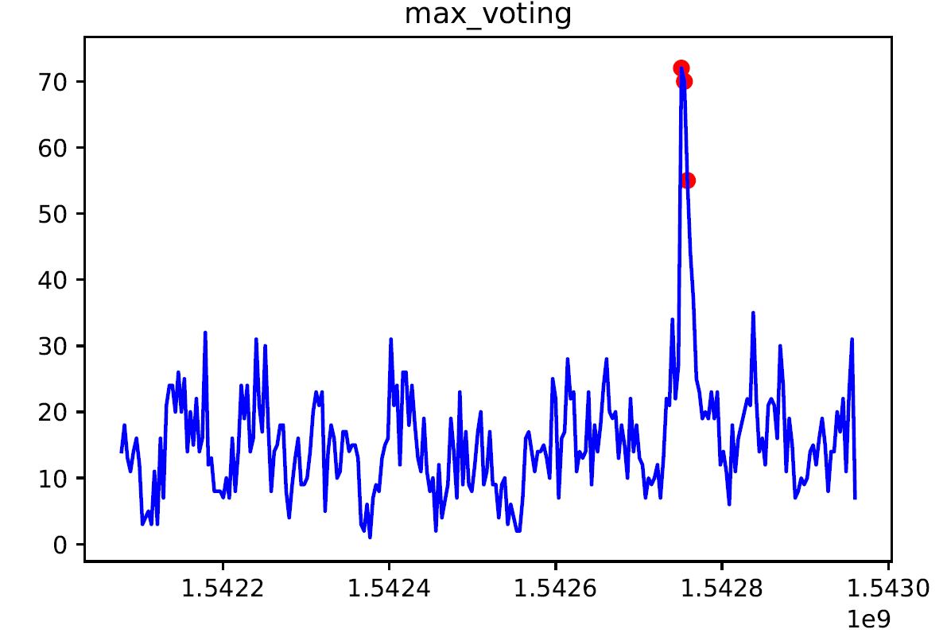
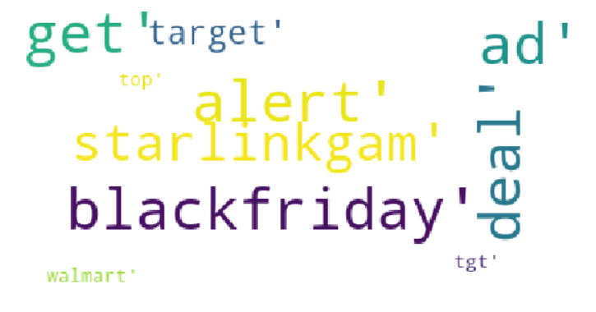
Deploying our framework on Real Twitter data could help companies in spotting trends quickly
Anomalous point picked up with the Max Voting Algorithm
Tweet Count for #Target
Time stamp
Word Cloud for the spike
Twitter Result
We extended our models to a real life application. We have used the Tweepy package in Python to scrape Twitter data after creating a Twitter Developer account. We can run our Anomaly Detection Algorithms on popular topics to check if there is any anomalies in it.
For the purpose of this demo, we have considered the hashtag “Target”, for the shopping chain, to check if there is any change to its trend, upon running the Tweet Count vs time data for the Tweets regarding “#Target” during the thanksgiving week, our model have identified the above points as anomalous.
The twitter package is also listing the same points as anomalous, hence the model is scaling well for twitter count data as well.
To understand the drivers for this spike we have also created a word cloud using the Bag of words approach.
Notes:
So now that we have benchmarked our algorithms on a standard anomaly detection dataset, you can ask us where can you use this?
Saw you are woking in a company and yo want to track what people information about your company on social media. In Social media you can track a lot things
1)what people are taking about your company
Specific products,
Competiors products
They maynot talk about your cmpny but can talk about the raw ingredients in general , your brand promotering clebriltes to name a few , Not it’s a pain to check this if there is any change in their behavior everyday. So for these cases our approach works well in saving time and effort . Let me give you an example ,
The graph you see contains count of tweets about the US chain target a little before the thanksgiving week, we scarapped this data from twitter.
Now our model was able to pick up this sudden change and woud have been able to alter the concerned team. So we don’t stop there we also create a word cloud on the day/hour of the spike to impeve reaction time.
u or your competitor are performing on social media, So you track the tweets about tour products, CEO, competr products their management on social media. Now you realisie there is so much to track.
Now instead of looking all these charts everyday you can use he AD framework to that work for you. So you can track the tweet count or sentiment about a particualt topic over time and use AD model will automatically altert you if there is a a issue.
We saw that the max voting
We got permission from the Twitter and scrapped their data using thr tweepy package. For experimental purposes we in the graph we y axis is the tweet count for
Ok you an alter, so what now? To addresss that we have used the bag of words approach to create a word clowrd. This entire framework will redcut the hours of manual work and reduce reaction time. So you can use this to track if sales or any of your metrics are deviating from standaed behaviout.

Slide 13


The performance of the models have also been benchmarked against the credit card dataset available on Kaggle
Method | Recall | AUC
One-class SVM | 0.876 | 0.953
Isolation Forest | 0.829 | 0.945
K-means | 0.843 | 0.897
Result
The algorithms could be extended to multi dimensional datasets with minimal modifications(Credit Card fraud Detection Data available on Kaggle)
Of all the algorithms One class SVM has the highest performance followed by K-means and Isolation Forest. Isolation Forest however runs much faster compared to the other two algorithms
All three of our models shows a high recall metric score of greater than 0.8. This implies that the models are able to tag most of the anomalies.
Right most image was obtained from : https://www.powerdms.com/resources/go-green/
Notes:
Now that we have see how our model picks up amolonies on time series data, now lets exapand it to multi dimensional data as well.
We have considered Kaggles credit card draud detection dataset for this purpose.
The data set is highly skewed, consisting of 492 frauds in a total of 284,807 observations. This resulted in only 0.172% fraud cases. This skewed set is justified by the low number of fraudulent transactions.
The dataset consists of numerical values from the 28 ‘Principal Component Analysis (PCA)’ transformed features, namely V1 to V28. Furthermore, there is no metadata about the original features provided, so pre-analysis or feature study could not be done.
The ‘Time’ and ‘Amount’ features are not transformed data.
There is no missing value in the dataset. As you can see from the recall and AUC score our models perfroms quite well for unsupervised learing. Again SVM pefoms quite well but Isolaiton forest runs a lot faster, so the best model has to be idefitied case by case.

Slide 14
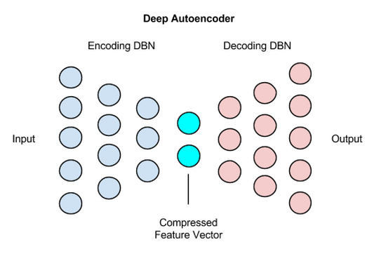
Autoencoder, an unsupervised Neural Network Approach for Anomaly Detection(Needs to be explored)
Autoencoder
One algorithm that has come up recently is the Autoencoder and needs to be explored further
Autoencoder is an unsupervised neural network algorithm which takes a data and compresses it and then reconstructs the same data
If we train our Autoencoder with sufficient non anomalous data it will be able to reconstruct the input with minimal change and now if anomalous data passes through the trained Autoencoder the reconstructing will be poor which will result in poor accuracy between the original data and the reconstructed
We can identify anomalous points based on the error between the original and reconstructed data.
Image obtained from https://skymind.ai/wiki/deep-autoencoder
Notes:
One algorithm that has come up recently is the Autoencoder and needs to be explored further
Autoencoder is an unsupervised neural network algorithm which takes a data and compresses it and then reconstructs the same data
If we train our Autoencoder with sufficient non anomalous data it will be able to reconstruct the input with minimal change and now if anomalous data passes through the trained Autoencoder the reconstructing will be poor which will result in poor accuracy between the original data and the reconstructed
We can identify anomalous points based on the error between the original and reconstructed data.

Slide 15

Any Questions?

